Slide 1
ANOVA, ANCOVA, Non-Parametric Statistics and Linear Regression

Slide 2
Outline of Contents
Analysis of Variance(ANOVA)
Analysis of Covariance(ANCOVA)
Non – Parametric Tests
Linear Regression and Correlation

Slide 3
Analysis of Variance(ANOVA)
What is ANOVA?
Assumptions for ANOVA.
Types of ANOVA.
ANOVA vs t-test.
How to run an ANOVA?

Slide 4
What is ANOVA?
It is an acronym for “Analysis of Variance”.
It is generally used to refer to the ANOVA test for significance.
It is used to asses the statistical significance of three or more group means for a single dependent variable.
It analyses the variance within groups and variance between groups to calculate an F statistic which is used to determine significance.

Slide 5
Assumptions for ANOVA
The sample must be random and independent.
The populations of DV for the groups must be approximately normally distributed.
Observations of DV are independent.
All groups must be homoscedastic (Homogeneous Variance).

Slide 6
Types of ANOVA
One Way ANOVA
  There is only one independent variable with two or more groups/levels.
Two Way ANOVA
  There are two independent variables with two or more groups/levels.
Factorial ANOVA
  ANOVA test with more than one independent variable or “factor”.
Repeated Measures ANOVA
  Same group of participants are measured over and over again, i.e. the samples are not independent.

Slide 7
ANOVA vs t-test
A Student’s t-test will tell you if there is a significant difference in mean between groups.
A t-test compares means, while the ANOVA compares variances between populations.
A series of t-tests could be performed in place of ANOVA, but the number of comparisons and the associated “FWER” grows very fast with the number of groups.
ANOVA gives a single value (the f-statistic) and one p-value to help support or reject the null hypothesis.

Slide 8
How to run an ANOVA test?
One Way ANOVA
  Find the mean for each group.
  Find the overall mean.
  Find the within group variation.
  Find the between group variation.
  Find the F statistic.

Slide 9
How to run an ANOVA test?
Two Way ANOVA
  Find the mean for each group/cell.
  Find the overall mean.
  Find the within group variation.
  Find the between group variation for each independent variable.
  Find the interaction variation.
  Find the F statistic.

Slide 10
Analysis of Covariance(ANCOVA)
What is ANCOVA?
Assumptions for ANCOVA.
Why use an ANCOVA?
Problems in ANCOVA.
How to run an ANCOVA?

Slide 11
What is ANCOVA?
It is an acronym for “Analysis of Covariance”.
It is a blend of ANOVA and regression, using regression it tries to explain the unexplained variance (within) with covariates.
It is an extension to ANOVA, where differences between the baseline groups are taken into account using covariates.

Slide 12
Assumptions for ANCOVA
Absence of Multicollinearity and singularity.
Normality of sampling distributions (of the means).
Homogeneity of Variance.
Linearity – of relationship between Covariate and dependent variable.
Homogeneity of regression – slope of the regression line for all treatment groups/cells is equal.

Slide 13
Why use an ANCOVA?
Reduction of within group or error variance.
  Increased sensitivity of a test of main effects and/or interactions due to reduction in error term.
Elimination of systematic bias.
  Adjust the means on the DV to what they would be if all subjects scored equally.
Stepdown Analysis.
  Compare scores on a DV after they are adjusted for scores on another DV, which is treated as a CV.

Slide 14
Problems in ANCOVA
The use of a covariate results in loss of one degree of freedom.
  A good covariate will result in much more precise error term that will result in an increase of statistical power.
  A poor choice of covariate will result in loss of a degree of freedom with no real gain.
Sample specific problems, or bias in CV can result in over or under correction.

Slide 15
How to run an ANCOVA?
One way ANCOVA
  Calculate SS_{wg} and SS_{bg} for the dependent variable as done in ANOVA.
  Perform regression on DV and CV and calculate r_{T} for DV and CV.
  Calculate r_{wg} the aggregate correlation between DV and CV within the groups.
  Use r_{T} and r_{wg} to adjust the between and within the group estimate of variances, and the DV means, for the covariate.
  Find the F statistic.

Slide 16
Non-Parametric Statistics
What is a Non-Parametric Test?
When to use Non-Parametric Tests?
Types of Non-Parametric Tests.
Non-Parametric and Parametric Alternatives.
Advantages and disadvantages of Non-Parametric tests.

Slide 17
What is a non-Parametric Test?
No assumptions for population’s distribution.
No assumptions for population parameters.
Lower or at most equal in statistical power to parametric tests.
Perform well with non-normal continuous data with sufficiently large sample size (15-20 in each group).

Slide 18
When to use Non-Parametric tests?
When data isn’t normally distributed.
For nominal and ordinal independent variables.
One or more assumptions of a parametric test have been violated.
Sample size is too small to run parametric test.
Data contains outliers that cannot be removed.

Slide 19
Types of Non-Parametric Tests
Spearman’s Rank Correlation
Mann-Whitney test
Kruskal-Wallis test
Friedman test
1-sample sign test
1-sample Wilcoxon Signed Rank test
Mood’s Median test

Slide 20
Non-Parametric tests and Parametric alternatives
Non-Parametric Test | Parametric Alternative
Spearman’s Rank Correlation | Pearson’s Correlation Coefficient
Mann-Whitney test | Independent samples t-test
Kruskal-Wallis test | One-way ANOVA
Friedman test | Two-way ANOVA
1-sample sign test | One sample t-test or a paired t-test
1-sample Wilcoxon Signed Rank test | One sample Z-test, One sample t-test
Mood’s Median test | One-way ANOVA

Slide 21
Advantages of Non-Parametric Tests
More statistical power when assumptions for parametric tests have been violated.
Small Sample sizes are acceptable.
Can be used for all data types, including nominal variables, interval variables, or data with outliers.
Fewer assumptions.

Slide 22
Disadvantages of Non-Parametric Tests
Less powerful than Parametric alternatives if the assumptions are not violated.
More labor-intensive to calculate by hand.
Critical value table for many tests are not included in many computer software packages as compared to tables for parametric tests.

Slide 23
Linear Regression and Correlation
Simple linear regression.
Pearson’s ‘r’ Coefficient of Correlation.
Multiple linear regression.

Slide 24
Simple Linear Regression
It is a technique for predicting the value of a dependent variable(y) based on the value of a single independent variable(x).
Simple Linear Regression models a bi-variate data as Line.
The differences between the predicted value and original data point are known as residuals.
Simple Linear Regression works on the principle of minimizing squared sum of residuals to create a best fit.

Slide 25
Simple Linear Regression
The calculations for the regression coefficients is done by the following compact formula:
b₁= r × s_{y}/s_{x}
b₀= ȳ – b₁ × x̄
where r = pearson’s coefficient of correlation
s_{y}, s_{x} = standard deviations of y and x
The final equation is given by the formula:
ŷ = b₀ + b₁x

Slide 26
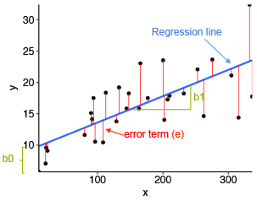
Simple Linear Regression
Here the blue line is the regression line.
The y intercept is b₀ and the slope of the line is b₁.
The red line segments represent the residual values of the linear regression model.

Slide 27
Pearson’s ‘r’ Coefficient of Correlation
It is the measure of linear correlation between two variables X and Y.
It is also known as normalized version of covariance.
It is given by the formula:
r = COV(X,Y) / (S_{x} × S_{y})
here, COV(X,Y) = covariance of x and y
S_{x} = standard deviation of x
S_{y} = standard deviation of y

Slide 28
Pearson’s ‘r’ Coefficient of Correlation
The value of pearson’s ‘r’ lies between -1 to 1, that is
r ϵ [-1 , 1]
A value of r close to 1 indicates a very strong positive linear correlation between the variables.
A value of r close to -1 indicates a very strong negative linear correlation between the variables.
A value of r close to 0 indicates a lack of correlation between the variables.

Slide 29
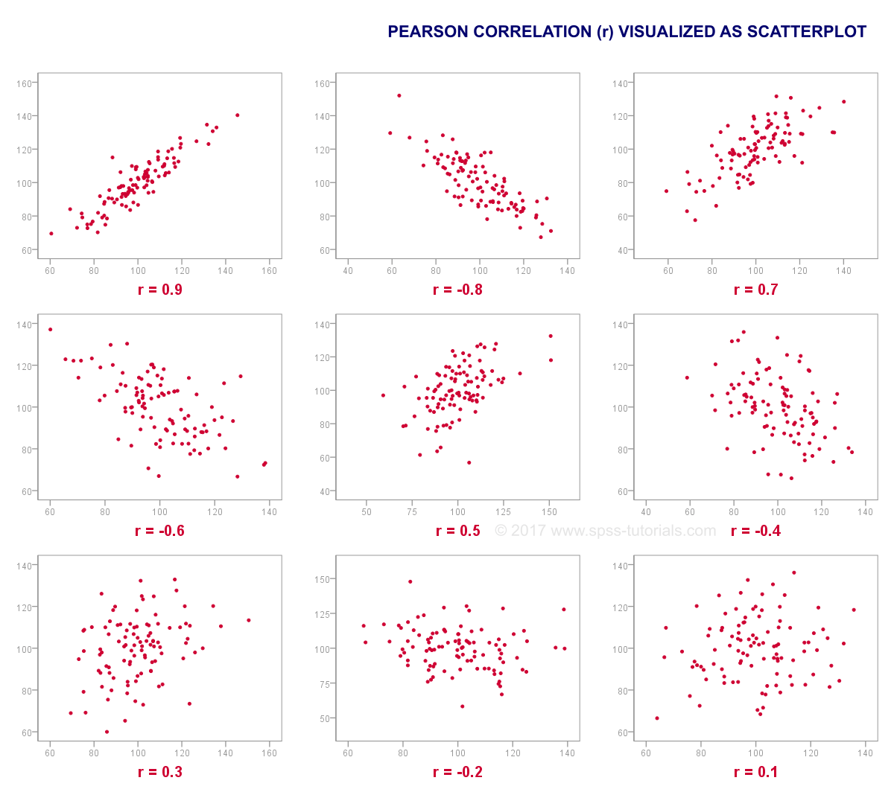
Pearson’s ‘r’ Coefficient of Correlation

Slide 30
Multiple Linear Regression
It is a technique for predicting the value of dependent variably based on the value of two or more independent variables.
Multiple Linear Regression models multi-variate data with one dependent variable as a hyper-plane.
The differences between the predicted value and the data value are known as residuals.
Just like Simple Linear Regression, Multiple Linear Regression works on the principle of minimizing squared sum of residuals to create a best fit.

Slide 31
Multiple Linear Regression
The calculations for the regression coefficients is done by the following compact formula:
b = (X'X)⁻¹X'Y
where, Y = column vector of dependent variable
  X = matrix of independent variables
The final equation is given by the formula:
ŷ = b₀ + b₁x₁ + … + b_{n}x_{n}
where, b_{i} is the i^{th} value of column vector b

Slide 32
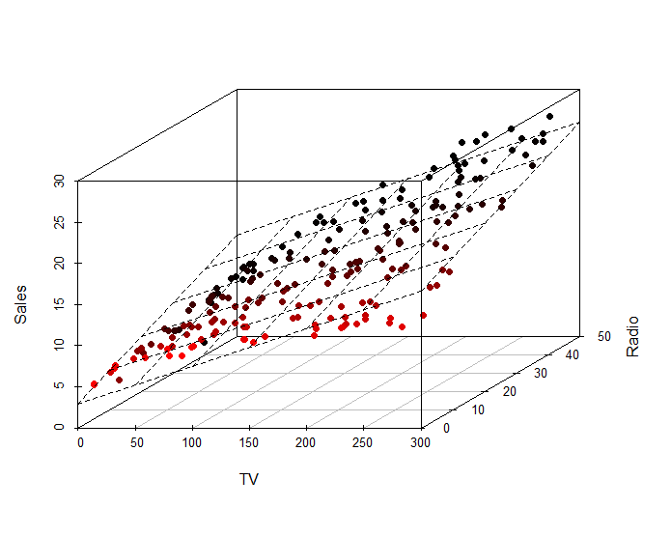
Multiple Linear Regression

